Slide 1
amazon
Power BI Dashboard Insights
Presented by:
Soumendu Ray
Imarticus Learning

Slide 2
01
Introduction
02
Project Overview
03
Feature Description
04
Data Cleaning & Preprocessing Steps
Contents
05
Basic Process Description
06
Risk and Challenges
07
KPI and Key Insights in MySQL and Power BI
08
Conclusion
09
References

Slide 3
Introduction
Welcome to the presentation on Amazon Product and Sales Analysis, where we delve into the trends using the power of data analytics.
Using Python , Power BI and SQL, we have meticulously analyzed Amazon data to uncover valuable insights that can drive strategic decision-making for growth of Amazon within the e-commerce Industry.
In this presentation, we will take you on a journey through the aromatic landscape of product sales, consumer behavior, and sales performance across different regions and product categories.
Join us as we unveil the hidden potential within data and empower with actionable insights to brew success in the competitive e-commerce market.

Slide 4
Project Overview
Objective:
The objective of this presentation is to demonstrate how Python Power BI and SQL were leveraged to conduct a comprehensive analysis of Amazon data. By combining the Data Processing Power of Python , analytical capabilities of Power BI with the robust querying power of SQL, we aim to:
Uncover key insights: Explore the intricacies of Amazon sales data to identify trends, patterns that provide valuable insights into consumer behavior and market dynamics.
Enhance decision-making: Empower stakeholders with actionable information to optimize product offerings, marketing strategies, and operational efficiency in the e-commerce industry.
Visualize data effectively: Utilize the interactive visualizations and dashboards created in Power BI to present complex sales data in an intuitive and easy-to-understand format, enabling stakeholders to gain deeper insights at a glance.

Slide 5

Feature Description
Customer
C_ID :- Customer ID of each and every unique customer
C_Name :- Name of the customers
Gender :- Male / Female
Age :- Age range between 18 and 70
City :- Name of the cities from where most customers order, especially Tier 1 and Tier 2 cities
State :- Name of the states from where most customers order
Address :- Address of the customers
Mobile_No :- Mobile number of the customers
Product
P_ID :- Product ID of each and every unique customer
P_Name ;- Name of the customers
Category :- Category under which the product lies
Specs :- Specification of the product
Price :- Price of that product

Slide 6
Orders
Or_ID :- Order ID of each and every unique orders
C_ID :- Customer ID for which customer has orderd .
P_ID :- Product ID for which product has been ordered
Order_Date :- At which date the product is been ordered
Qty :- How much the product is been ordered
Coupon :- Which coupon been used by the customer while ordering
DP_ID :- Delivery ID for ordered delivered by which delivery guy
Transactions
Tr_ID :- Transaction ID of each and very unique transaction for the order
Or_ID :- Order ID for which transaction used for which order
Transaction_Mode :- For which mode used for Transaction
Tran_Status :- Whether the transaction was successful or unsuccessful
Delivery
DP_ID :- Delivery ID of each and very unique Delivery guy
DP_Name :- Name of the delivery guy
DP_Ratings :- Rating provided to the delivery guy

Slide 7
Subscription_Plan
Plan_ID :- Plan ID of each and very unique Subscription Plan
Plan_Name :- Name of the Plan used
Features :- Features provided based of the Plan
Plan_Price :- Price of each and every Plan (Monthly Subscription)
Subscription_Details
SD_ID :- Subscription ID of each and very unique Subscription Plan taken
C_ID :- Customer ID of which plan taken by which customer
Plan_ID :- Plan _ID for which plan taken by which customer
From_Date :- At which date the subscription is taken
To_Date date :- Upto which date the subscription will last

Slide 8
Rating
R_ID :- Rating ID of each and very unique Rating
Or_ID :- Order ID on which order of product the rating is given
Prod_Rating :- Rating of the product based on order
Delivery_Service_Rating :- Rating of the delivery service provided
Return / Refund
RT_ID :- Return ID of each and very unique Return product
Or_ID :- Order ID for which product is returned by which customer
Reason :- Reason for return the product
Return_Refund :- Whether the product to be return or refund
R_Date :- At which date the order is returned

Slide 9
Importing Data
Handling null values
Removing duplicates
Delete irrelevant features
Checking Data types
Connecting My Sql with Python and Power BI
Import Data from Python to My SQL
Generating Queries based on requirements
Generate KPI’s
Dashboard Building
Uncover insights
Background Design in Power Point
Explain Insights along with conclusion
Data Cleaning
& Preprocessing Steps

Slide 10
Basic Process Description
Here the process is mentioned for how the Data is imported from Python to MySql based on their respective tables and then from MySql to PowerBI for further analysis. The process involves:
After Data Cleaning and Preprocessing using Python , Data is imported to MySQL using MySql Connector with the help of library PyMySql , imported on their respected tables,
After Query Generating , Data imported from MySql to Power BI with the help of option “ Get Data → MySql Database” for KPI and Graph generation
Import Data
My SQL
Import Data
Python
Power BI
Get Data
(My SQL Database)
My SQL Connector
(PyMySQL library)

Slide 11
Data Availability and Quality
Need to invest time in data preprocessing and cleansing to make it usable for visualization.
Connecting MySql with Python and PowerBI
Designing an effective dashboard requires understanding the needs and creating visualizations that are informative.
Large datasets or complex visualizations can impact the performance of the dashboard.
Since Data includes many categorical features, handling them and creating insights takes a lot of time.
Making interactive, informative and user friendly dashboards takes a lot of time and analysis.
Creating conclusions requires lot of time and analysis
Risk and Challenges

Slide 12
KPI and Key Insights in
MySQL and PowerBI

Slide 13
SQL

Slide 14
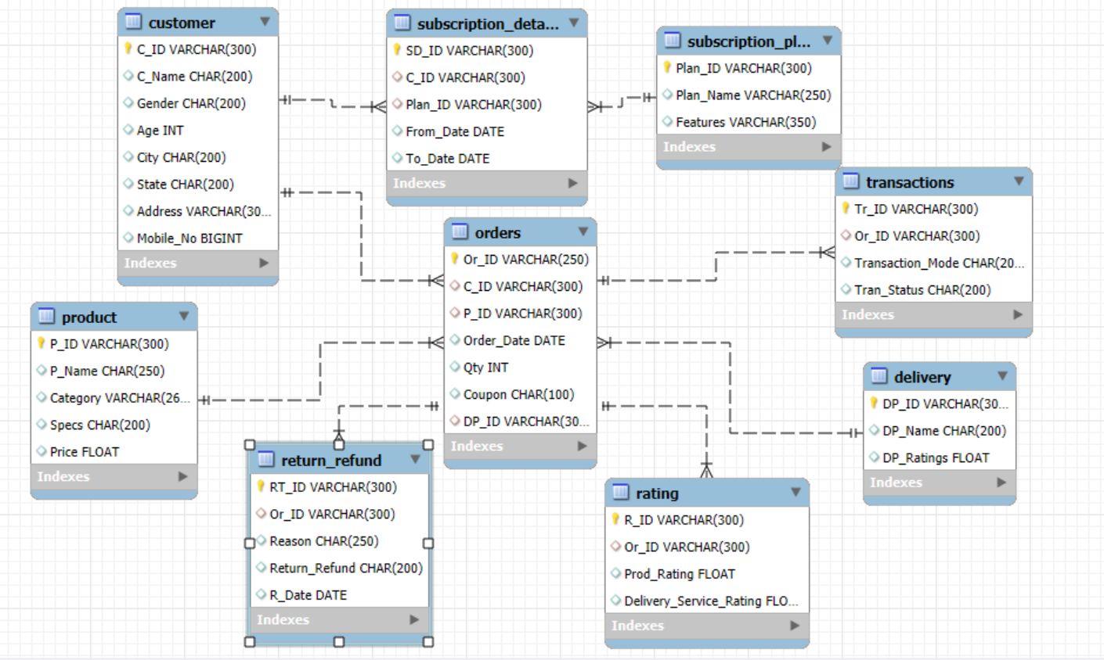
ER-Diagram
Display which table is interlinked with which table, using common column:
Customer(C_ID) ←→ Orders(C_ID)
Product(P_ID) ←→ Orders(P_ID)
Rating(Or_ID) ←→ Orders(Or_ID)
Return_Refund(Or_ID) ←→ Orders(Or_ID)
Transactions(Or_ID) ←→ Orders(Or_ID)
Subscription_details(C_ID) ←→ Customers(C_ID)
Subscription_details(Plan_ID) ←→ Subscription_Plan(Plan_ID)
Delivery(DP_ID) ←→ Orders(DP_ID)

Slide 15
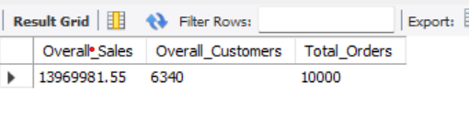
KPIs
Sales Dashboard
Customer Dashboard

Slide 16
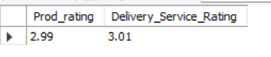
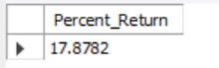
KPIs
Product and Sales Dashboard

Slide 17
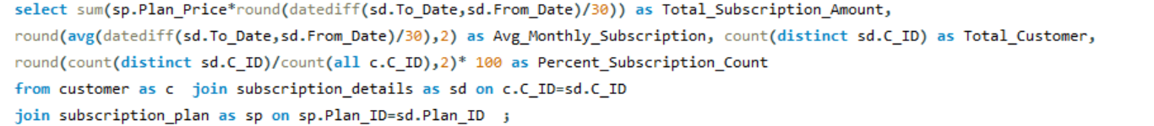
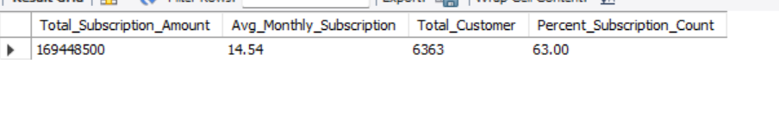
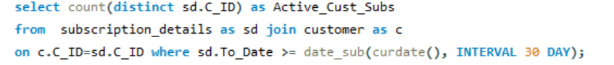
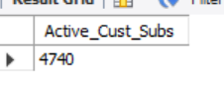
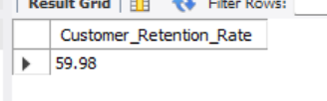
KPIs
Subscription Dashboard

Slide 18
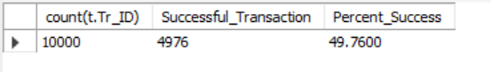
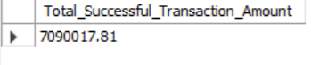
KPIs
Transaction Dashboard

Slide 19
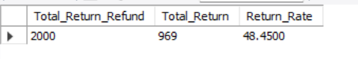
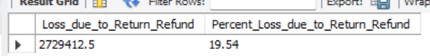
KPIs
Return/Refund Dashboard

Slide 20
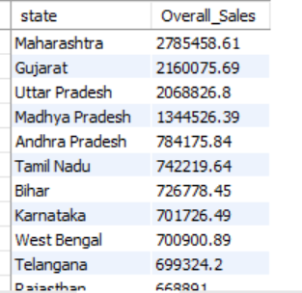
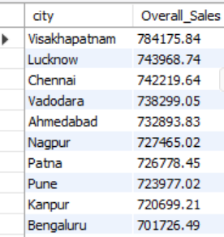
Insights (Sales Dashboard)

Slide 21
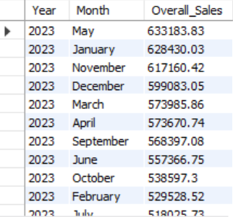
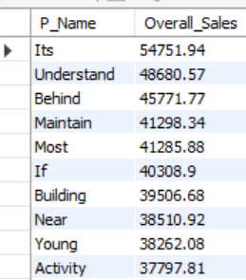
Insights (Sales Dashboard)

Slide 22
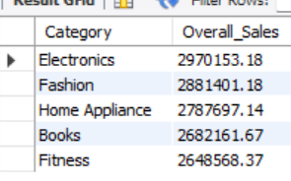
Insights (Sales Dashboard)

Slide 23
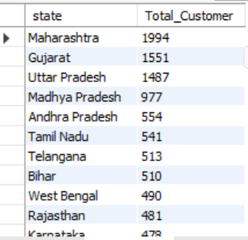
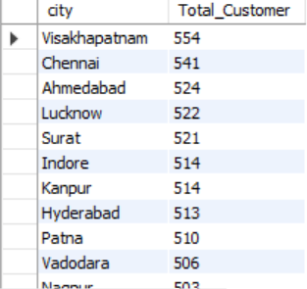
Insights (Customer Dashboard)

Slide 24
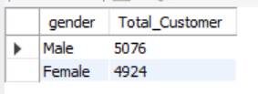
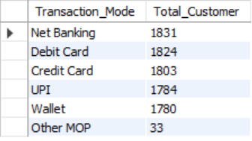
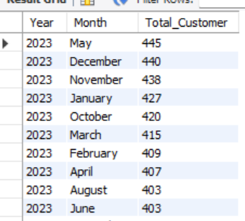
Insights (Customer Dashboard)

Slide 25
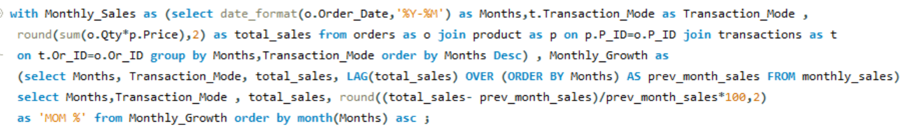
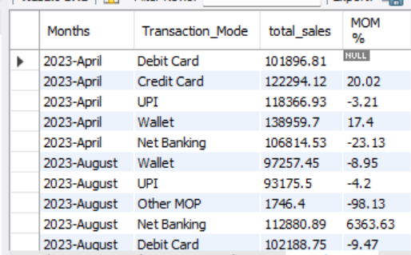
Insights (Product & Sales Dashboard)

Slide 26
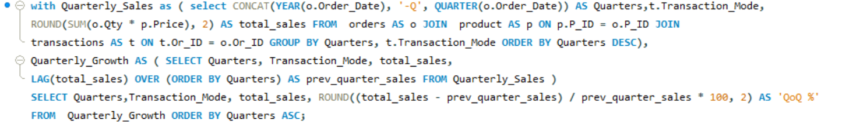
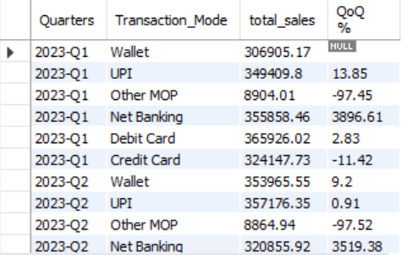
Insights (Product & Sales Dashboard)

Slide 27
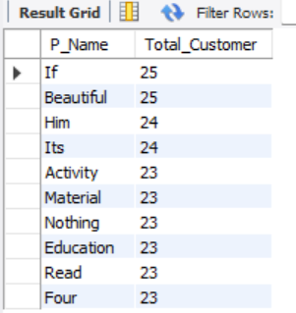
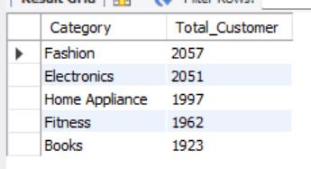
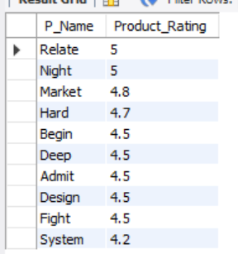
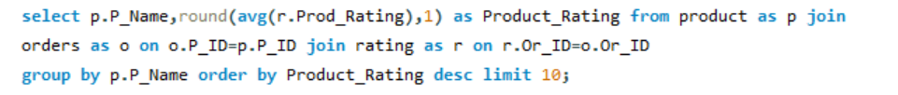
Insights (Product & Sales Dashboard)

Slide 28
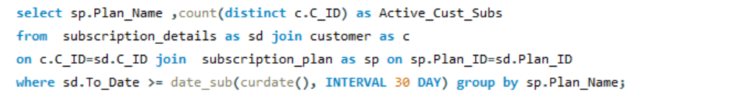
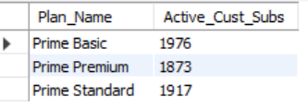
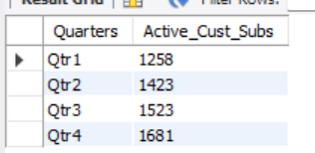
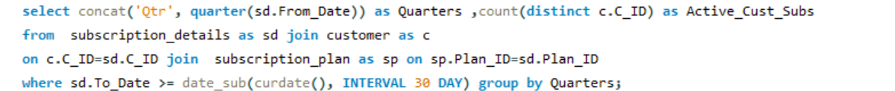
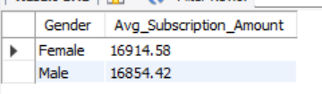
Insights (Subscription Dashboard)

Slide 29
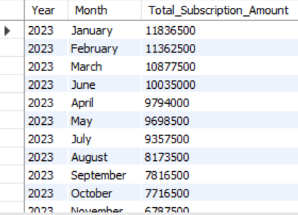
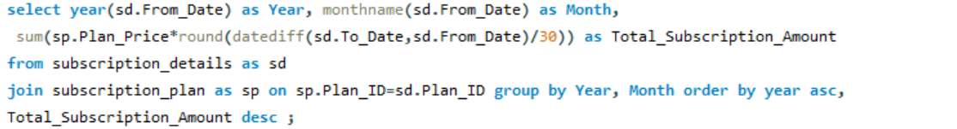
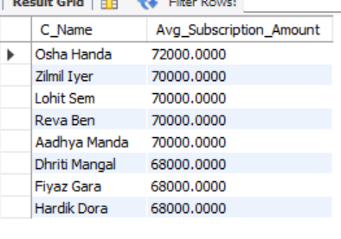
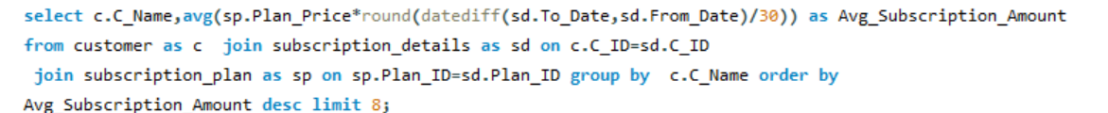
Insights (Subscription Dashboard)

Slide 30
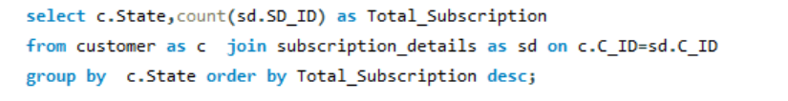
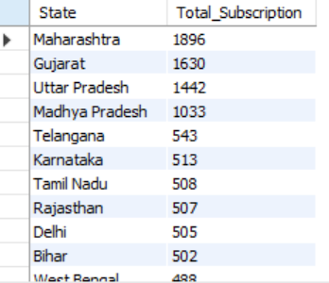
Insights (Subscription Dashboard)

Slide 31
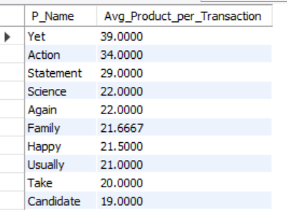
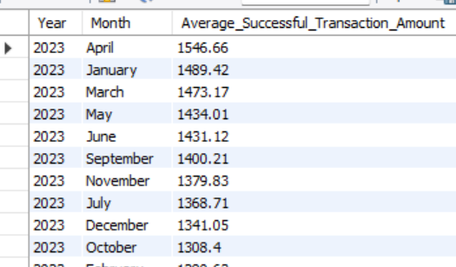
Insights (Transaction Dashboard)

Slide 32
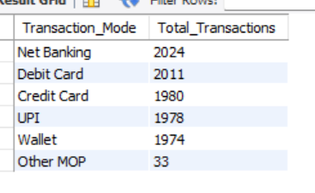
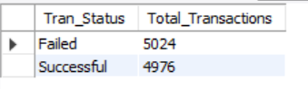
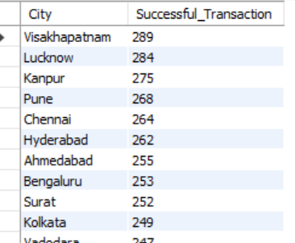
Insights (Transaction Dashboard)

Slide 33
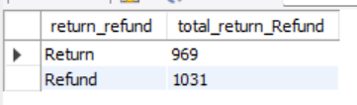
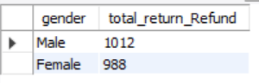
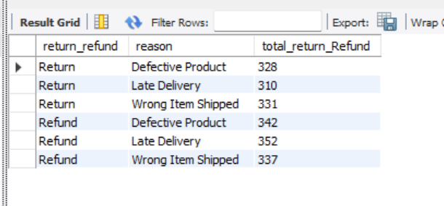
Insights (Return/Refund Dashboard)

Slide 34


Insights (Return/Refund Dashboard)

Slide 35



Insights (Return/Refund Dashboard)

Slide 36
Power BI

Slide 37

Sales Dashboard

Slide 38


Insights (Sales Dashboard)
From this Area Chart we can Define Monthwise Sales Based on Year
From this Tree Map we can Define Sales by Category

Slide 39


Insights (Sales Dashboard)
From this Bar Chart we can Define Sales Based on Cities
From this Map we can Define Sales by State

Slide 40

Customer Dashboard

Slide 41


Insights (Customer Dashboard)
From this Stacked Column Chart we can define Gender vs Age Total Customer
From this Pie Chart we can Define Total Customer based on Gender
From this Column Chart we can define City wise Total Customer

Slide 42


Insights (Customer Dashboard)
From this Pie Chart we can Define Total Customer based on Gender
From this Column Chart we can define Total Customer using which Transaction Mode
From this Map we can Define Total Customer based onState

Slide 43

Product & Sales Dashboard

Slide 44

Insights (Product & Sales Dashboard)
From this Area Chart we can define MOM% Sales
Based on Year
From this Area Chart we can define QOQ% Sales
Based on Year

Slide 45


Insights (Product & Sales Dashboard)
From this Finnel Chart we can define Top 10 Product bought
From this Funnel Chart we can define Top 10 Porduct with highest rating

Slide 46

Subscription Dashboard

Slide 47


Insights (Subscription Dashboard)
From this Tree Map we can define Active Customer per Quarter based on Year
From this Pie Chart we can define Avg. Spending based on Gender
From this Pie Chart we can define Active Customer based on Plan

Slide 48


Insights (Subscription Dashboard)
From this Area Chart we can define Total Sales by Subscription
Based on Year
From this Map we can define Customer Taken Subscription Plan

Slide 49

Transaction Dashboard

Slide 50

Insights (Transaction Dashboard)
From this Funnel Chart we can define Average Product based on per Transaction
(Qty/Total Transaction)
From this Bar graph we can define Total Successful Transaction based on Age Group
From this Area Chart we can define Average Successful Transaction Amount Monthwise based on Year

Slide 51


Insights (Transaction Dashboard)
From this Pie Chart we can define Status of the Transaction
From this Column Chart we can define which transaction mode is use
From this Map we can define Total Successful Transaction based on Cities

Slide 52

Return/Refund Dashboard

Slide 53


Insights (Return/Refund Dashboard)
From this Donut Chart we can define Total Product Return/Refund
From this Bar Graph we can define Amount Loss due to Total Product Return/Refund
From this Pie Chart we can define Gender based Total Return/Refund

Slide 54



Insights (Return/Refund Dashboard)
From this Bar Chart we can define which Product Return/Refund the most (Top 5)
From this Table we can define Reason for Product Return/Refund along with its count
From this Area Chart we can define Monthwise Loss due to Return/Refund
Based on Year

Slide 55
The analysis provides insights into:
Top-performing products and categories
Customer demographics and behavior (State and Cities)
Returns and refunds patterns
Subscription buying pattern
Transaction analysis
Year , Quarter and Month based Sales Analysis
These insights help optimize sales strategies and improve customer satisfaction.
Conclusion

Slide 56
Synthetic Data Creation The dataset used in this project was synthetically generated using ChatGPT. The data was designed to simulate real-world scenarios, including the presence of null, blank, and inappropriate entries, for the purpose of analysis and cleaning.
Guidance and Support I would like to express my sincere gratitude to my friends and teacher, whose valuable guidance and feedback were instrumental in shaping this project.
Python, Power BI and SQL The Data Cleaning & Preprocessing done by Python and analysis and visualizations were carried out using Power BI and SQL, leveraging these tools to create meaningful insights from the synthetic data.
Self-Learning Resources Various online resources and tutorials were utilized to understand the nuances of data analytics and visualization.
References

Slide 57
Thank
You

